Slide 1
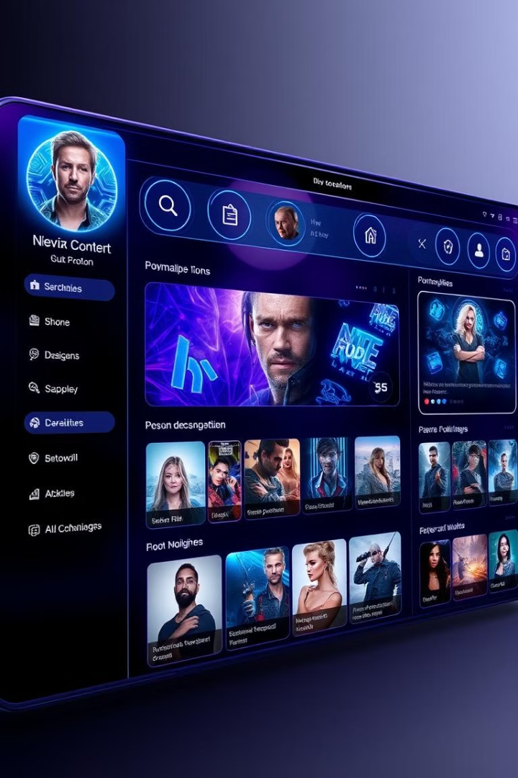

Recommender Systems: Unlocking Personalized Experiences
Recommender systems are revolutionizing how we discover content. These AI-powered tools analyze user preferences to suggest relevant items. From streaming services to e-commerce, they're reshaping our digital experiences.
by Lokesh Chalasani| AP22110010676

Slide 2

What are Recommender Systems?
1
Data-Driven Algorithms
2
Personalization Engines
Recommender systems use machine learning to analyze user behavior and preferences.
They tailor suggestions to individual users, enhancing engagement and satisfaction.
3
Cross-Industry Applications
These systems are used in e-commerce, entertainment, social media, and more.

Slide 3




Types of Recommender Systems
Collaborative Filtering
Relies on user-item interactions to make predictions.
Content-Based Filtering
Recommends items similar to those a user has liked in the past.
Hybrid Approaches
Combines multiple techniques for more accurate recommendations.

Slide 4
Collaborative Filtering
User-Based
Item-Based
Matrix Factorization
Finds similar users and recommends items they've liked.
Suggests items similar to those the user has interacted with.
Discovers latent factors to predict user-item interactions.

Slide 5

Content-Based Filtering
Item Profiles
User Preferences
Creates detailed profiles of items based on their features.
Builds user profiles from their historical interactions and preferences.
Similarity Matching
Continuous Learning
Recommends items with profiles similar to the user's preferences.
Updates user profiles as they interact with more items.

Slide 6

Hybrid Approaches
1
Weighted Hybrid
Combines scores from multiple recommender systems.
2
Switching Hybrid
Chooses between different techniques based on the context.
3
Feature Combination
Incorporates features from different approaches into a single algorithm.

Slide 7




Personalized Recipe Recommendation System: A Case Study
User Preferences
Captures dietary restrictions, cuisine preferences, and cooking skill level.
Ingredient Analysis
Considers available ingredients and suggests recipes accordingly.
Time Constraints
Recommends recipes based on the user's available preparation time.

Slide 8
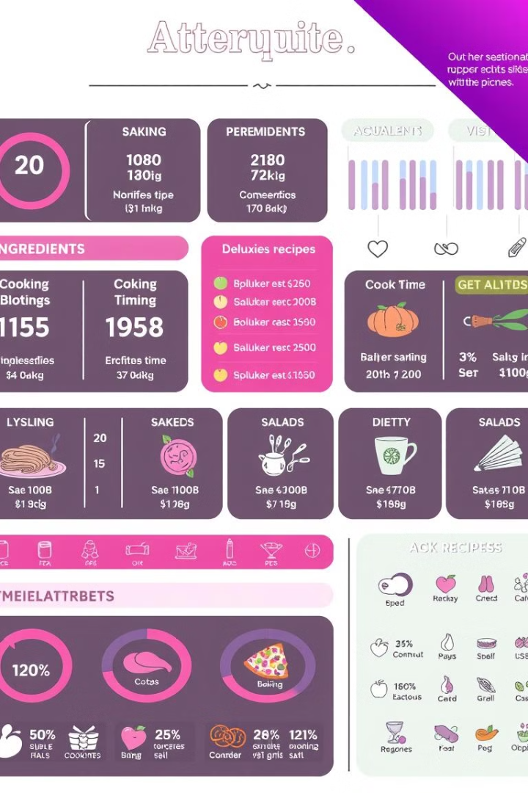
Data Considerations for Recipe Recommendations
User Data
Recipe Data
Interaction Data
Dietary preferences
Ingredients
Ratings
Allergies
Cooking time
Favorites
Skill level
Nutritional info
Click-through rates

Slide 9
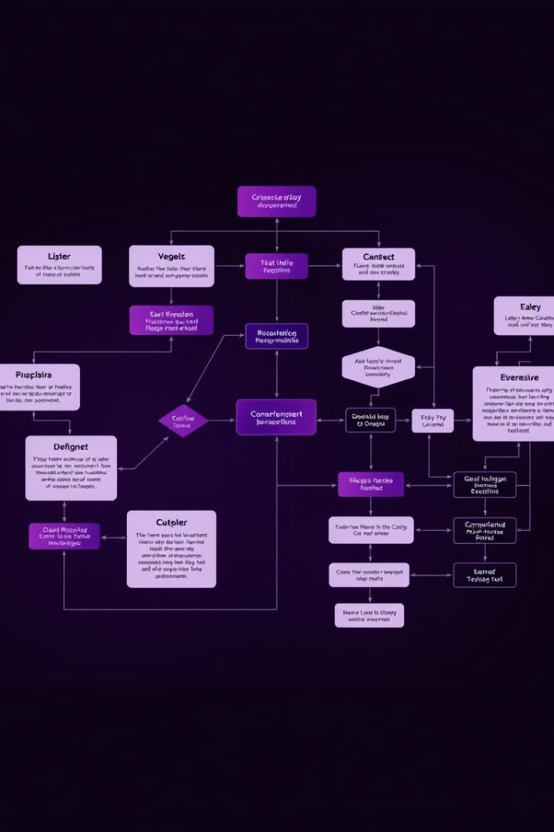
Algorithms and Techniques
1
Content-Based Filtering
Matches recipe attributes to user preferences.
2
Collaborative Filtering
Suggests recipes liked by similar users.
3
Matrix Factorization
Uncovers latent factors in user-recipe interactions.
4
Deep Learning
Uses neural networks for more nuanced recommendations.

Slide 10
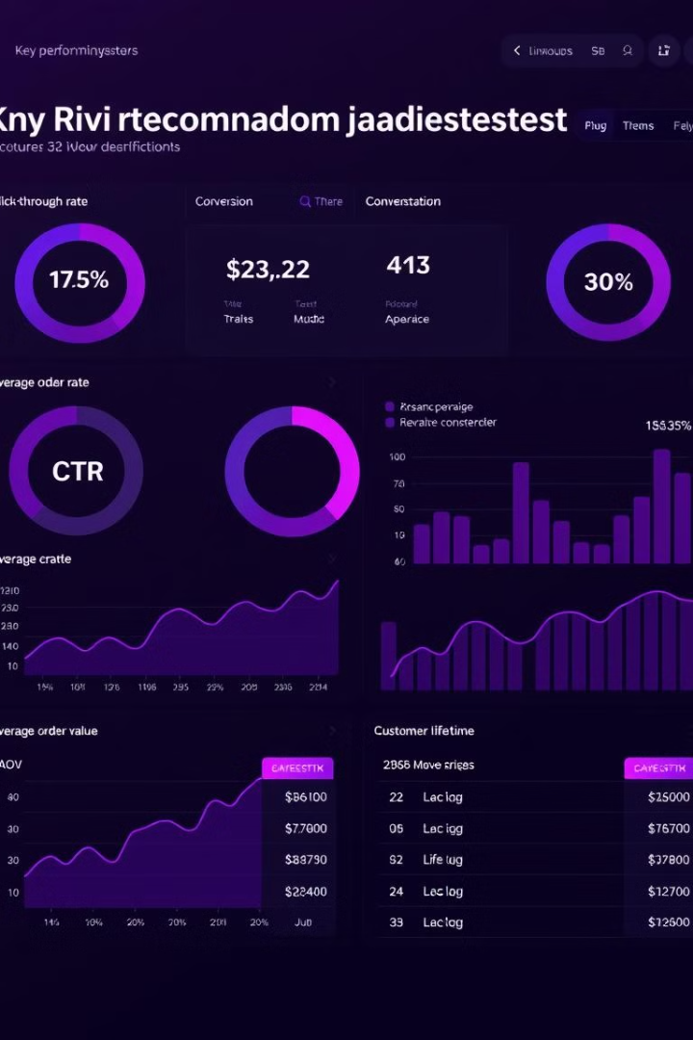
Measuring Effectiveness: Metrics and Evaluation
1
Accuracy Metrics
2
Engagement Metrics
Precision, recall, and F1 score measure recommendation relevance.
Click-through rates and time spent indicate user interest.
3
Business Metrics
4
User Satisfaction
Conversion rates and revenue growth show real-world impact.
Surveys and feedback provide qualitative insights into system performance.

Slide 11
Personalized Recipe Recommendations: A Case Study Conclusion
The personalized recipe recommendation system successfully leveraged user data, recipe information, and interaction data to provide relevant and engaging recommendations.
The case study demonstrated the effectiveness of hybrid approaches in combining different recommendation techniques.
Evaluation metrics such as accuracy, engagement, and business impact showed the system's positive influence on user experience and overall business goals.

